Slide 1



PROJECT REPORT
Pillow Palooza Short-term Rental Market Analysis: Key Insights and Recommendations, 2023

Slide 2
AGENDA
Q3
2020
01
Executive Summary
02
Business questions & Answer
03
Recommendation
04
Conclusion

Slide 3



TEAM
Q3
Stakeholders
2020
Emily Chen
Samantha Patel
Head of Marketing
CEO
Nathaniel Obafemi
Data Analyst

Slide 4

01
Executive Summary
To begin with, I have conducted an in-depth analysis of the short-term rental market in New York City.
Aim: To provide insights and recommendation by optimizing the company's revenue.

Slide 5
Most popular Neighbourhood in NY.

Slide 6
Neighbourhood | Room Type | Avg Price ($)
Sea Gate | entire home/apt | 805
Tribeca | entire home/apt | 450
Bayside | entire home/apt | 398
Flatiron District | entire home/apt | 386
SoHo | entire home/apt | 383
NoHo | entire home/apt | 344
Vinegar Hill | Shared room | 250
The average rental price for short-term rentals in New York City

Slide 7
Most Rented Property Types

Slide 8
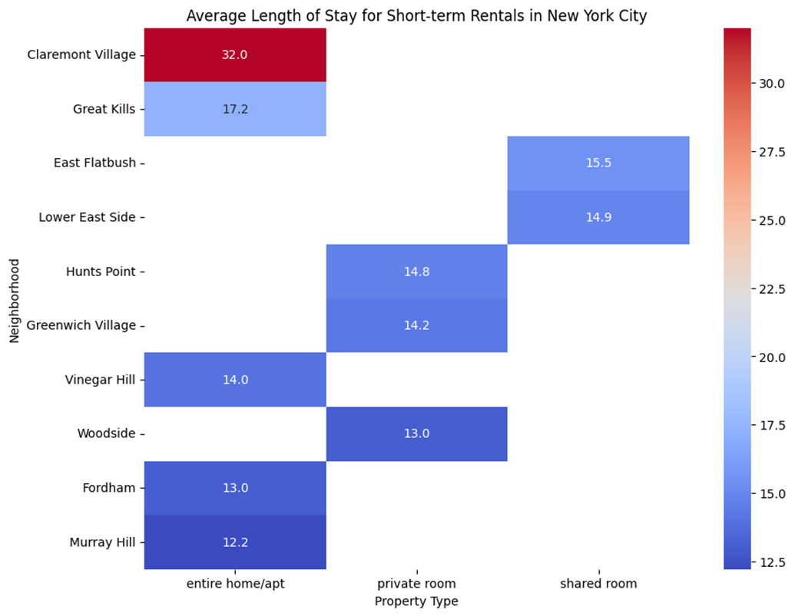

Slide 9
DEMAND FOR SHORT-TERM RENTALS OVER TIME

Slide 10
SUMMARY
Q3
2020
OUR GOAL
Based on the analysis of the short-term rental market in New York City, Pillow Palooza should focus on investing in properties in popular neighbourhoods such as Bedford-Stuyvesant, Williamsburg, and Harlem.
By setting competitive rental prices, understanding the most rented property types, adapting to the average length of stay, and capitalizing on seasonal demand, Pillow Palooza can maximize revenue and occupancy rates.
Recommendation

Slide 11
SUMMARY
Q3
2020
OUR GOAL
These recommendations aim to guide the company's growth and success in the competitive short-term rental market, while addressing the specific needs and responsibilities of key stakeholders, including the CEO, VP of Data, Head of Finance, and Head of Marketing.
By leveraging data-driven insights and strategies, Pillow Palooza can position itself as a leader in the New York City short-term rental market and drive sustainable growth.
Conclusion

